Slide 1
Vehicle Analysis Empowering consumers to make informed decisions when purchasing a car

Slide 2
Objectives
- Provide a comprehensive analysis of vehicle values for different car makes and models.
- Determine vehicle values of popular car brands over time.
- Identify key features that influence a car's value.
- Offer recommendations for consumers seeking high-value vehicles with better market value.

Slide 3

Overview of the Dataset Total records: 1,796 Variables included: Vehicle Make: the manufacturer or brand of the vehicle. Price ranges: various price ranges of vehicles in the dataset. Location: all data pertains to vehicles located in India. Years: data covers vehicles manufactured between 2015 and 2021. Fuel type: vehicles in the dataset are classified as either petrol or diesel.

Slide 4
Distribution of car makes
Audi
BMW
Ford
Honda
Hyundai
Jeep
Land Rover
MINI
Mercedes-Benz
Porsche
Toyota
Volkswagen
Volvo
Land Rover
MINI
Mercedes-Benz
Porsche
Toyota
Volkswagen
Volvo

Slide 5
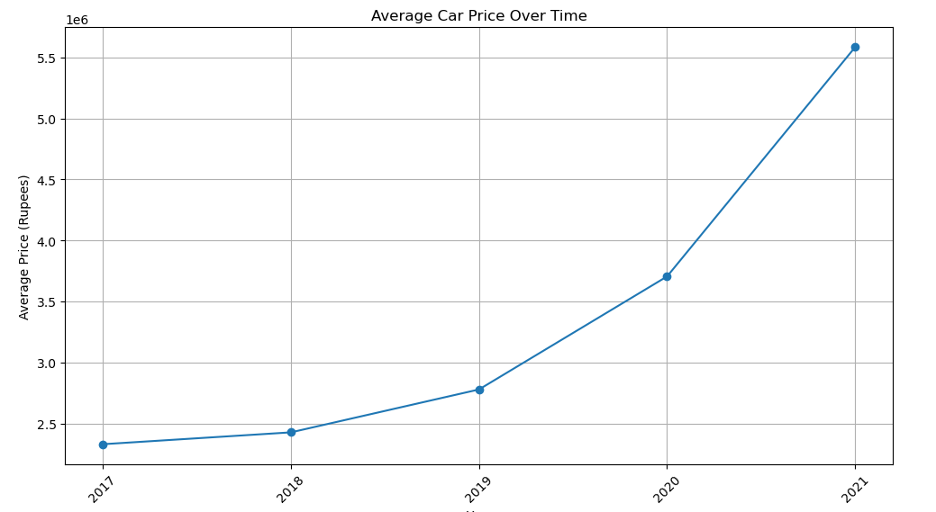
Price distribution

Slide 6
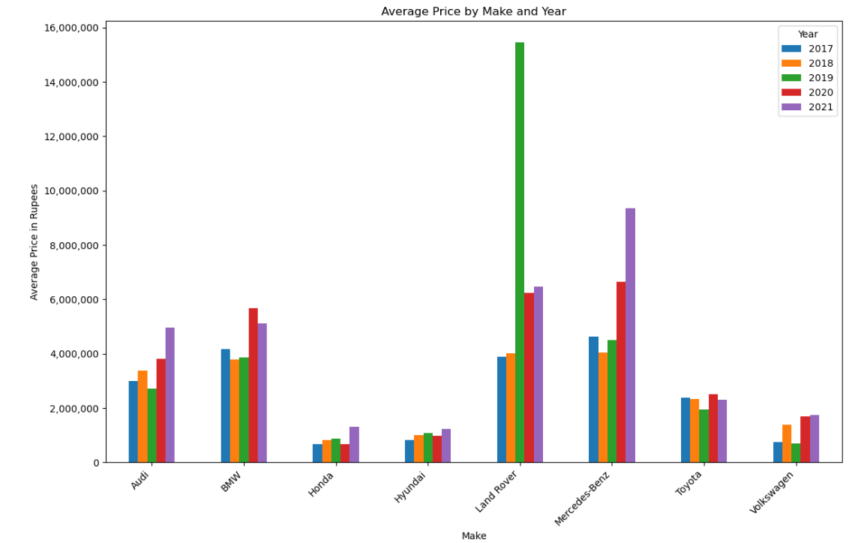

Slide 7
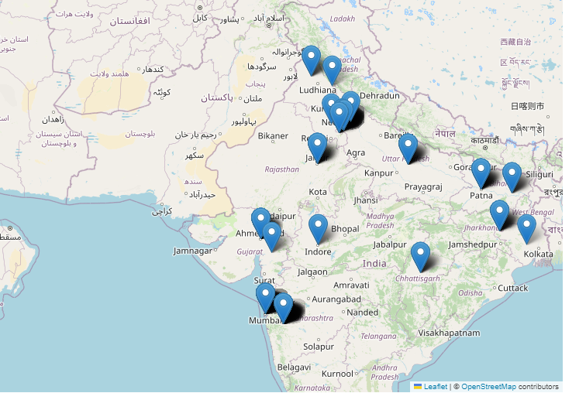
Geographic distribution of car sales
Enhancing your presentation

Slide 8
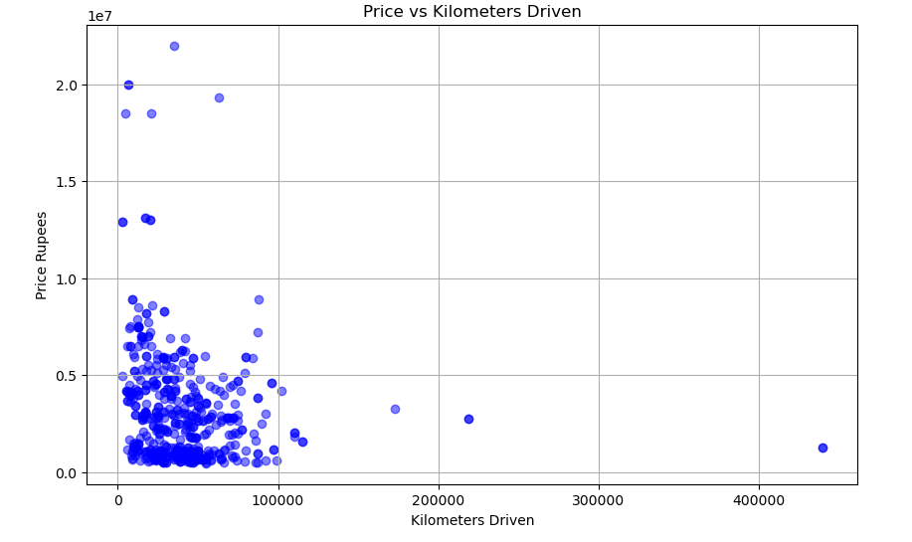
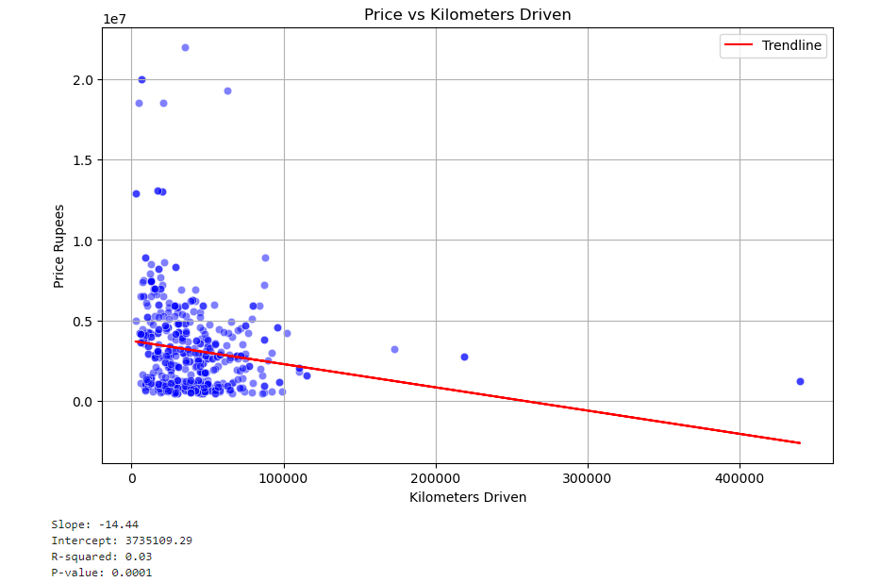

Slide 9
Analysis of trends over the years
Know your material in advance​
Anticipate common questions​
Rehearse your responses
Maintaining composure during the Q&A session is essential for projecting confidence and authority. Consider the following tips for staying composed:​
Stay calm​
Actively listen​
Pause and reflect​
Maintain eye contact

Slide 10

Conclusion and key insights
Your ability to communicate effectively will leave a lasting impact on your audience​
Effectively communicating involves not only delivering a message but also resonating with the experiences, values, and emotions of those listening

Slide 11
Final tips & takeaways​
Consistent rehearsal​
Practice makes perfect, so strengthen your familiarity with the presentation​
Refine delivery style​
Pacing, tone, and emphasis​
Timing and transitions​
Aim for seamless, professional delivery​
Practice audience
Enlist colleagues to listen & provide feedback​
Seek feedback​
Reflect on performance​
Explore new techniques​
Set personal goals​
Iterate and adapt

Slide 12
THANK YOU
Anna Ramer
annaramer@yahoo.com
Ben Fish
Benjamin.Fish426@gmail.com

